Slide 1
CAPSTONE PROJECT
AIRBNB BOOKING ANALYSIS
Pradeep Singh

Slide 2

CONTENT
BUSINESS UNDERSTANDING
DATA SUMMARY
FEATURE ANALYSIS
EXPLORATORY DATA ANALYSIS
DATA PREPROCESSING
CHALLENGES
CONCLUSIONS

Slide 3

BUSINESS UNDERSTANDING
In this project we are analyzing on airbnb data of 2008
This dataset has around 49,000 observations in it with 16
columns and it is a mix between categorical and numeric values
which describes information regarding the Airbnb property
listings, host, location, property type, price, minimum nights,
number of reviews, and availability.
Our goal here is to perform an exploratory data analysis on the
Airbnb NYC dataset, which could help in understanding the
story the dataset entails.

Slide 4
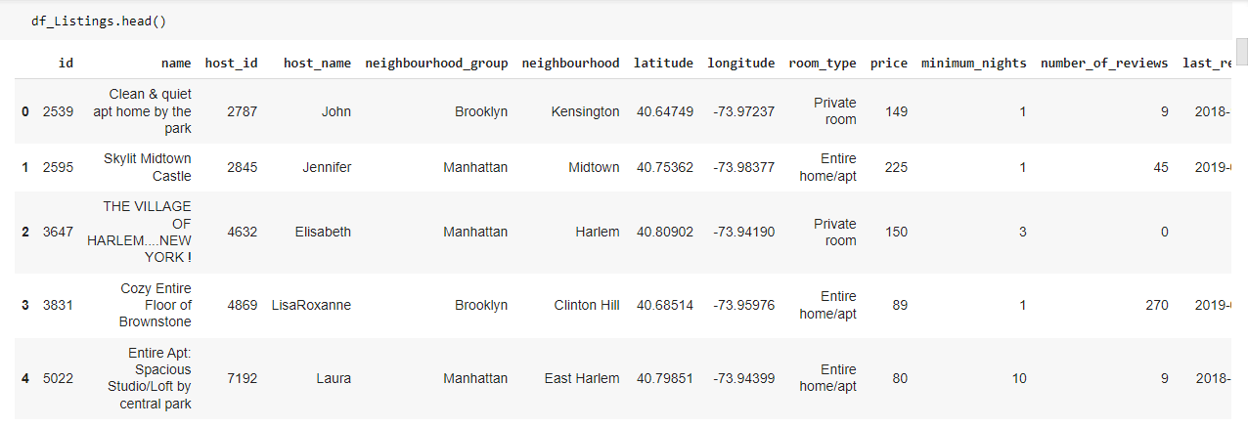
DATA SUMMARY
This Dataset contains 48895 lines and 16 columns.
Some of the ‘Categorical’ type features like name, host_name, neighborhood_group, neighborhood, room_type, last_review.
Some of the ‘Integer’ type feature like id, host_id, latitude, longitude, price, minimum_nights and more.

Slide 5
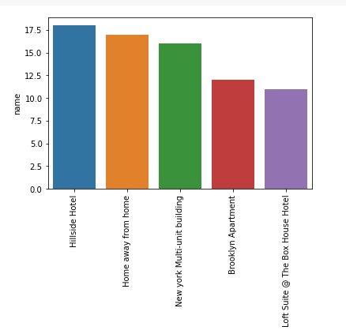
ANALYSIS OF HOTEL NAME COLUMN
The countplot shows that maximum number of Airbnb hotal ‘name’ that is Hillside Hotel
The second highest Airbnb hotal ‘name’ is Homeaway from home

Slide 6
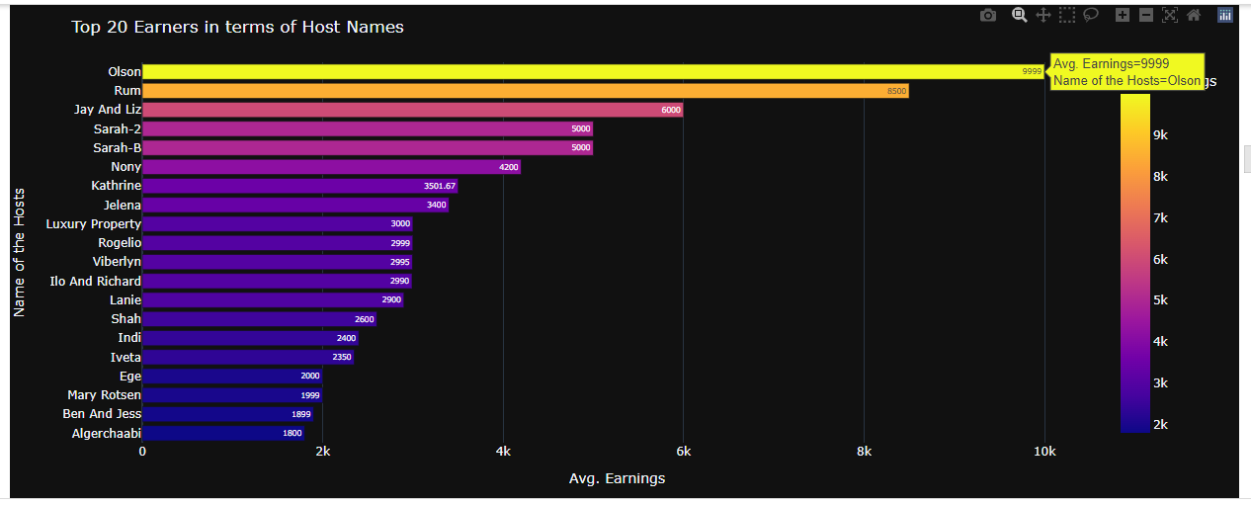
ANALYSIS OF HOST NAME COLUMN
In the Top 20 Earners in terms of Host Names, top most earners is ‘Olson’ and second highest is ‘Rum’
And the bottom most earners in the list are ‘Algerchaabi’ and the second below name is ‘Ben And Jess’

Slide 7
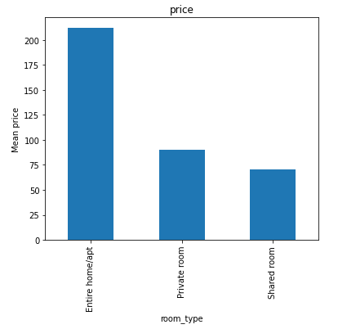
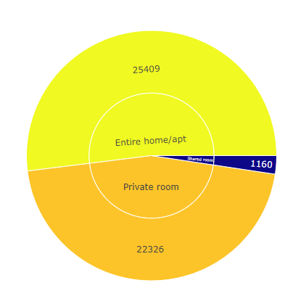
ANALYSIS OF ROOM TYPE
From the above plot we see that the Entire home/apt has the more price and the shared room has the lowest price

Slide 8
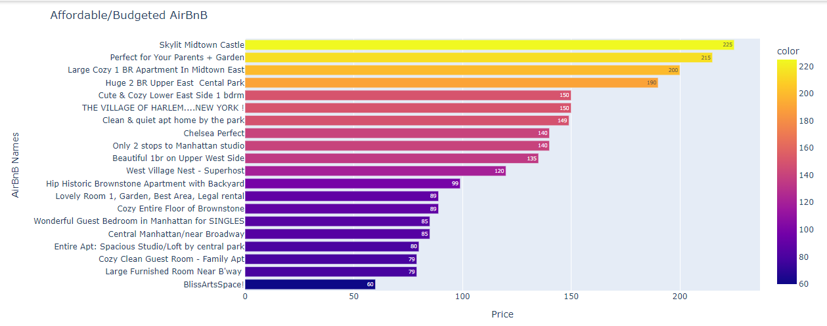
ANALYSIS OF PRICE_NAME
From the above plot we seen that in the top 20 Affordable Airbnbs the skylit Midtown Castle is the most Affordable Airbnb Hotel
we seen that the BlissArtsSpace is the least Affordable Airbnb Hotel

Slide 9
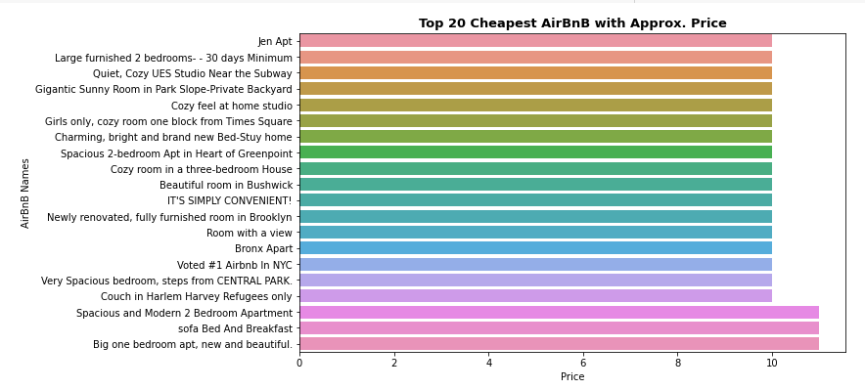
ANALYSIS OF CHEAPEST AIRBNBS
From the above plot we seen that in the top 20 Cheapest Airbnbs the jen Apt is the most Cheapest Airbnb Hotel

Slide 10
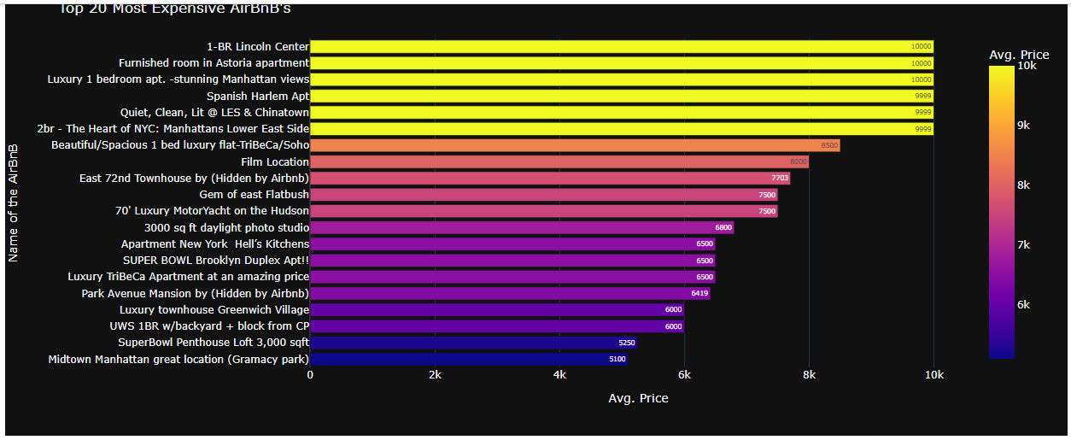
ANALYSIS OF ROOM TYPE
From the above plot we seen that in the top 20 Most Expensive Airbnbs room is the 1- BR Lincoln Centre Hotel room

Slide 11
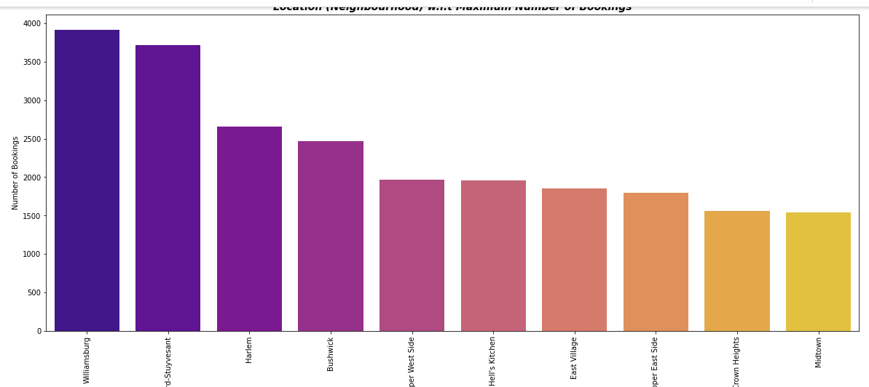
ANALYSIS OF LOCATION WISE BOOKING
In the above count plot shows that the Williamsburg is the Highest nuber of bookings
In the above count plot shows that the Midtown is the lowest nuber of bookings

Slide 12
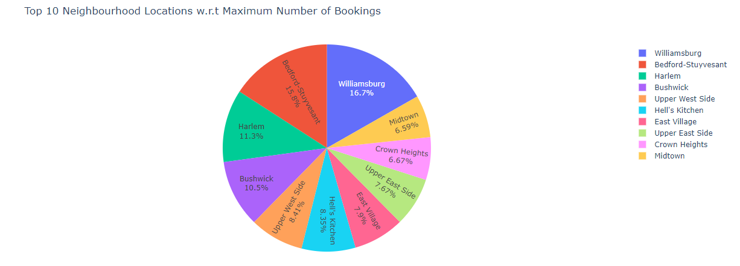
MAXIMUM NUMBER BOOKING
In the top 10 Number of Bookings of percentage the Williamsburg is the 16.75%
And the least Number of Booking is the Midtown which is percentage wise is 6.59%

Slide 13
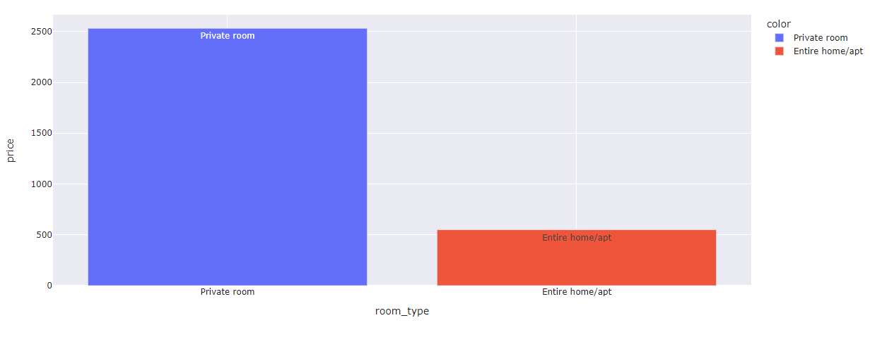
Analysis of room_type
the Number of private room is the around 2600 & the number of the Entire home/apt is the around 600

Slide 14
CHALLENGES
Large Dataset to handle.
Needs to plot lot of Graphs to analyse.
Do the lot of EDAs for relationship between the features
Feature engineering
Feature selection
Get lot of conclusions which will highly affect the data set

Slide 15
CONCLUSION
Top 20 Earners in terms of Hosts, one after the other. We can say that "Olson" is the Top Earner followed by "Rum" and "Jay And Liz".
In the feature of 'name' the maximum count of Hillside Hotel is 18
We can observe the one thing that Mostly Guests prefer "Entire room/apt" Rooms not Much Expensive, nor Much Less.
We can say, "Entire home/apt" was the First Choice/Most Preferred Room Type by approx. '52%' Guests followed by "Private Room" and "Shared Room" which are about '45.7%' & '2.37%' respectively.
We can say, "Shared Room" has much Less Preferred by the Guests. This might because of there is a likelihood/possiblity like Most of the Guests Not prefer to Stay in Shared Room.
We have Total "110454" AirBnB's which are the Affordable/Budgeted AirBnB's that are below "500". It means, these are come under our "Budget Hotel" as well as they are "Affordable".
the "Luxury 1 bedroom apt. -stunning Manhattan views", "Furnished room in Astoria apartment" & "1-BR Lincoln Center" are the Most Expensive ones followed by "Rosecrans Beauty" and "180 View La Jolla Ocean Front".
Most of these/Almost All these Expensive ones has bookings for "Entire home/apt" as a Room Type. Hence, It seems to be like Most of the guests prefer to Stay in "Entire home/apt" and AirBnB has More Earners from these kind of Room Types.

Slide 16
CONCLUSIONS
In terms of Neighbourhood Locations, Most of the Bookings were takes place for "Williamsburg " of around "16.7%" followed by "Bedford-Stuyvesant", "Harlem " which has "15.8%" & "11.3%" respectively...
In terms of Neighbourhood Locations, Most of the Bookings were takes place for "Williamsburg " of around "16.7%" followed by "Bedford-Stuyvesant", "Harlem " which has "15.8%" & "11.3%" respectively...
Top 20s AirBnB's that are located at "Astoria" and "Green point", were Super Expensive and at the same time, there are less Number of AirBnB's available which are "Bushwick & Flatiron District.
best Location (Neighbourhood) with lower Priced AirBnB has Most of the Bookings / Most preferred by the Guests.
As "Green point" Location has Moderate Level Priced, Most of the guests preferred to Stay there. Next, If we see the "East flatbush" on, Prices are slightly high compared to "Green point". Hence, less number of guests prefer to stay here than "Green Point".
Most of the guest prefer to have bookings for "best Locations (Neighbourhood)" and at the same time, "Moderate level Priced" AirBnB's.

Slide 17
THANK YOU

